Slide 1

Introduction to SQL Server Mirroring & Log Shipping
SQL Saturday #120 Orange County, CA

Slide 2
Contact Info:
Blog: http://blogs.h2dclan.com
Twitter: @SQLDude503
Email: Harry.Chandra@h2dclan.com
LinkedIn: http://www.linkedin.com/in/harrychandra

Slide 3
What is High Availability??
IT IS NOT THE SAME AS DISASTER RECOVERY
Microsoft HA Definition:
“A high-availability solution masks the effects of a hardware or software failure and maintains the availability of applications so that the perceived downtime for users is minimized”

Slide 4
SQL Server High Availability Options
Database Log Shipping
Database Mirroring
Database Replication
Failover Cluster
AlwaysOn - HADRON (New in SQL Server 2012)

Slide 5
Log Shipping - Components
Primary Database
Secondary Database
Monitor Server (Optional)
SQL Agent Jobs
Backup Job (Primary)
Alert Job (All)
Log Shipping Tables & Stored Procedures
http://msdn.microsoft.com/en-us/library/ms175106.aspx
Copy Job (Secondary)
Restore Job (Secondary)

Slide 6
Log Shipping - Prerequisites
Databases involved needs to be in Full Recovery or Bulk-Logged Recovery mode
Requires a Shared folder where Log backups will be copied into (SQL Agent Service Acct needs access to the folder)
Primary and Secondary servers needs to have the same case-sensitivity settings

Slide 7
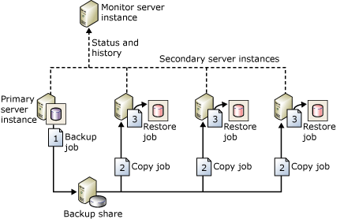
Log Shipping - Example

Slide 8
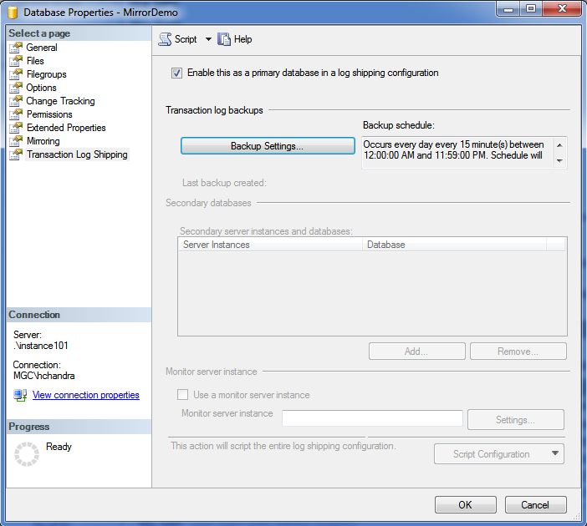
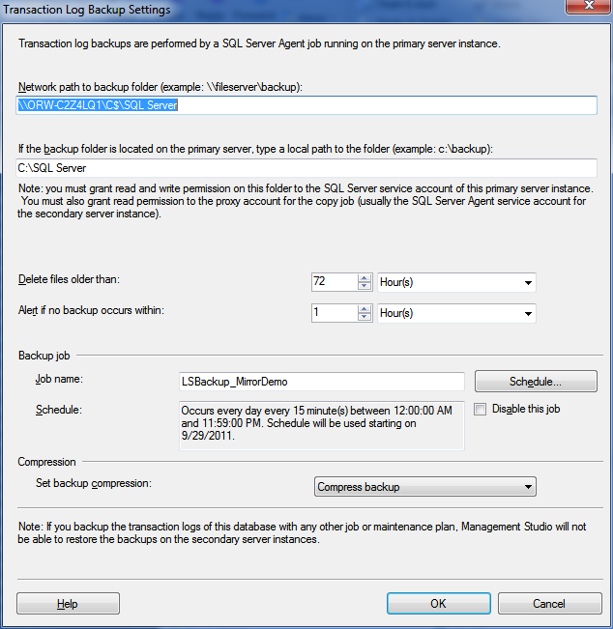
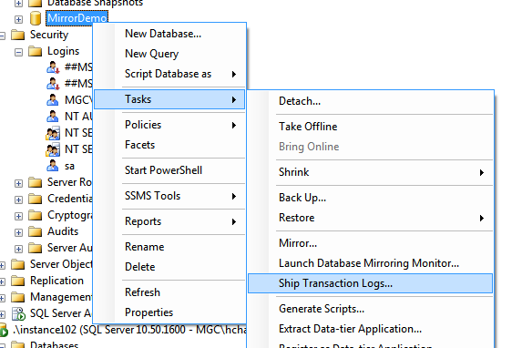
Log Shipping – Setup

Slide 9
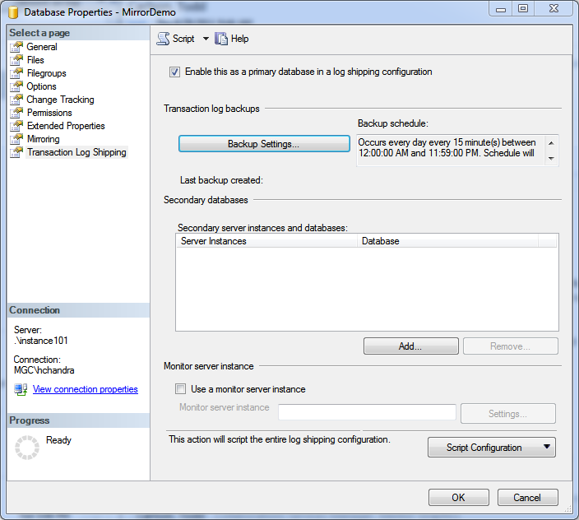
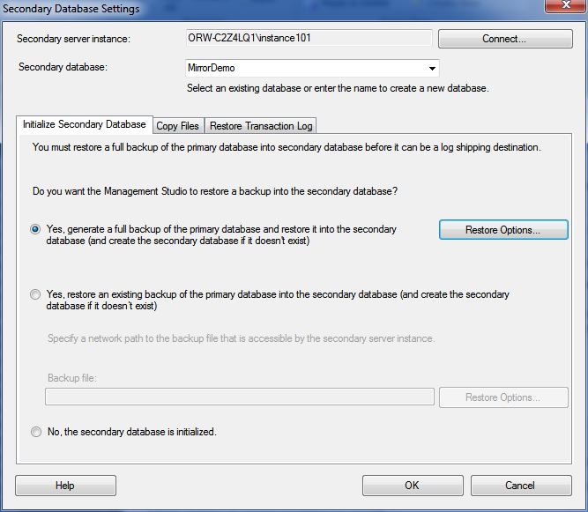
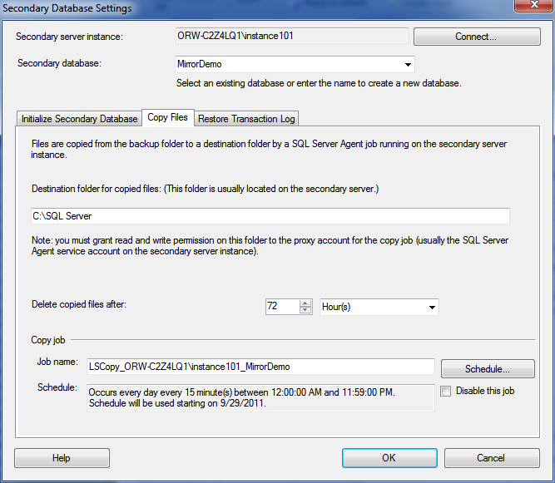
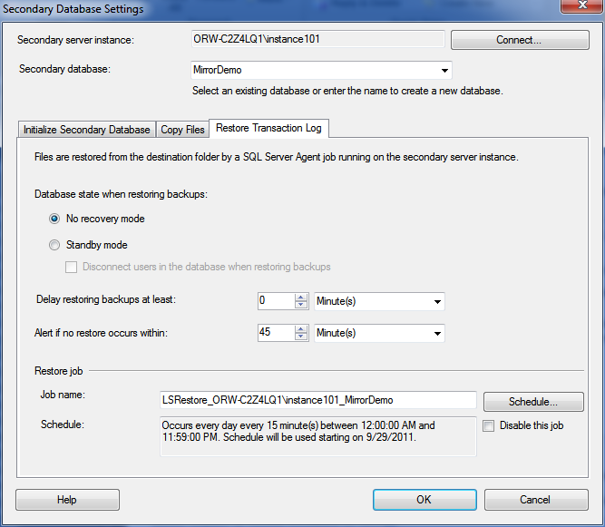
Log Shipping – Setup

Slide 10
Log Shipping – Failover
Disable Log Shipping backup job on primary server
Backup Tail log with NORECOVERY option
Copy tail log backup to Secondary server
Restore all unrestored log backups in sequence with NORECOVERY on Secondary server
Restore Tail log backup with Recovery on Secondary
Setup Log Shipping from Secondary to Primary

Slide 11
DEMO: Setting Up Log Shipping

Slide 12
Database Mirroring
Provide protection from database failures
Operating modes:
Synchronous (High-Safety Mode)
With Automatic Failover (Requires Witness Server)
Asynchronous (High Performance Mode)
Data Center
Yes
Enterprise
Yes
Standard
Yes (Single thread, Synchronous Only)
Others
Witness Only

Slide 13
Database Mirroring - Components
Principal
Mirror
Witness Server (Optional)
Endpoint
Active Database
In Recovery / Restoring Database
Quorum
Network Protocol object
Session
Connection between servers involved in Mirroring

Slide 14
Database Mirroring - Prerequisites
Principal and Mirror servers must be running the same edition and version of SQL Server (*)
Servers involved should use the same collation.
Principal and Mirror database has to have the same name.
Use NORECOVERY option when restoring the Mirror database.
On 32-bit system, database mirroring can support the maximum of about 10 databases per server instance.
Check Firewall setting to allow traffic on Mirroring Endpoint port (5022)
Grant CONNECT for Service Account running principal server to Endpoint on mirror server and vice versa

Slide 15
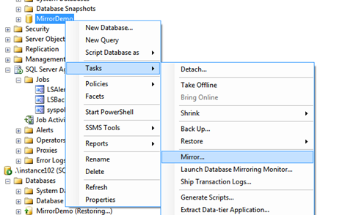
Mirroring – Setup

Slide 16
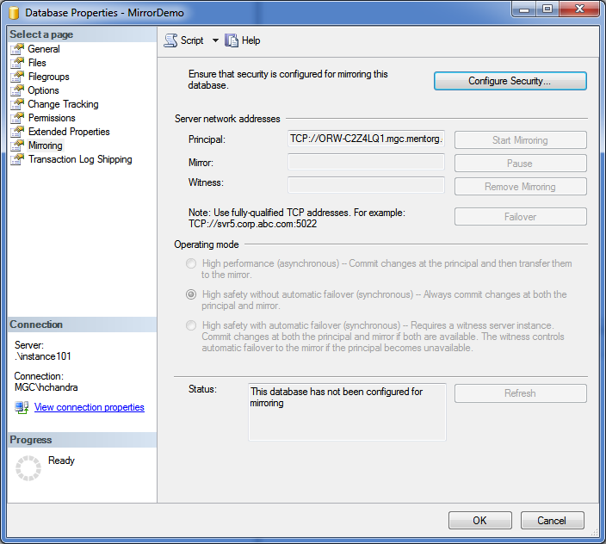
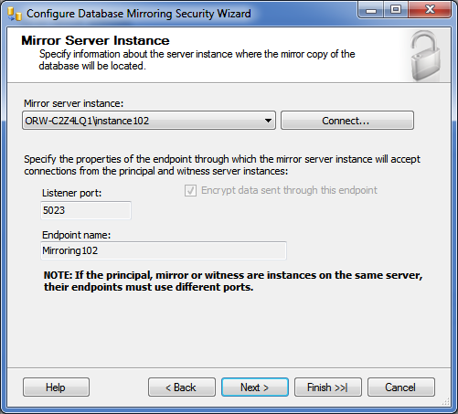
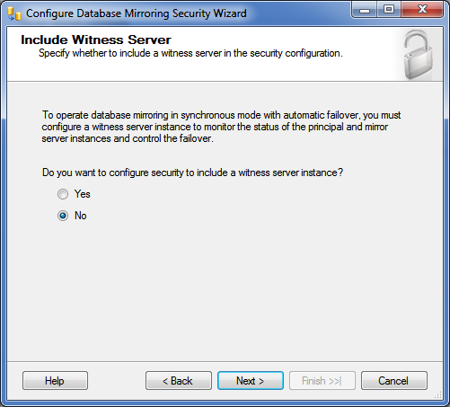
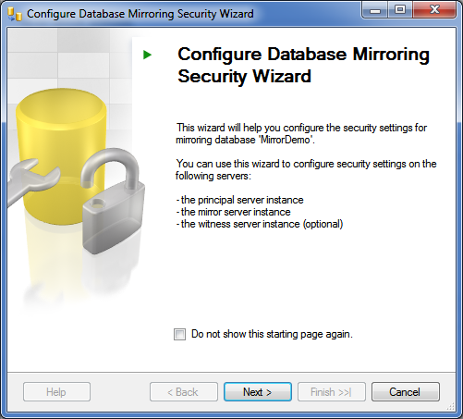
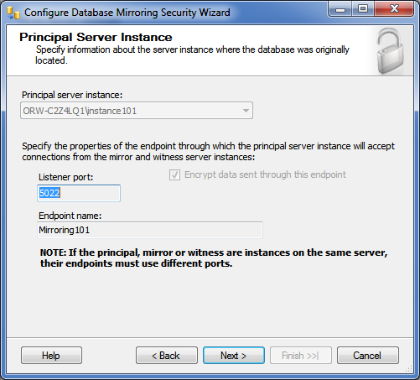
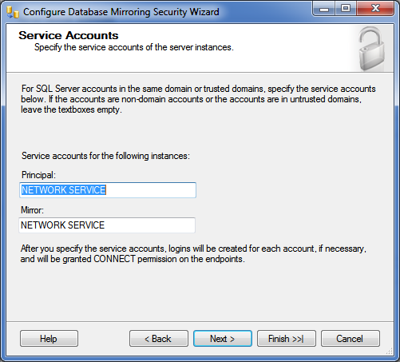
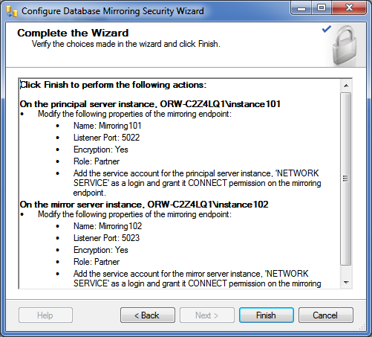
Mirroring – Setup

Slide 17
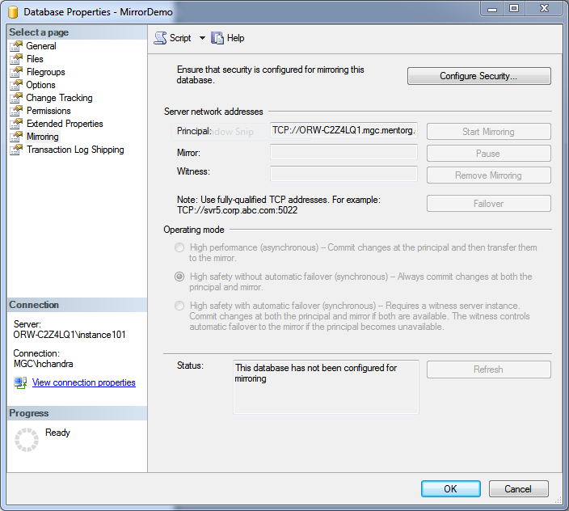
Mirroring – Failover
ALTER DATABASE [DB Name] SET PARTNER FAILOVER
OR

Slide 18
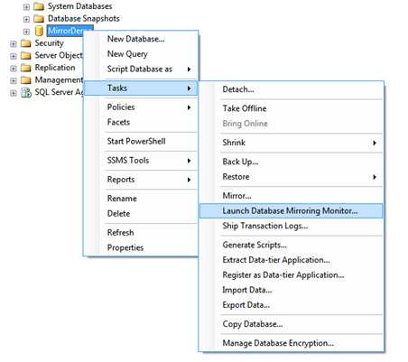
Mirroring – Monitoring

Slide 19
DEMO: Setting Up Mirroring

Slide 20
Reading Materials
Pro SQL Server 2008 Mirroring – Robert Davis / Ken Simmons
http://www.sqlsoldier.com/wp/tag/databasemirroring
http://msdn.microsoft.com/en-us/library/cc645993.aspx#High_availability
http://msdn.microsoft.com/en-us/library/ms187103.aspx
http://msdn.microsoft.com/en-us/library/ms175106.aspx
http://msdn.microsoft.com/en-us/library/bb934127.aspx
http://msdn.microsoft.com/en-us/library/ms365781.aspx

